Slide 1



Hospitality Domain Project 2.0
View in Power BI
Last data refresh:
19/01/2025
Created by:
Deepanshu

Slide 2
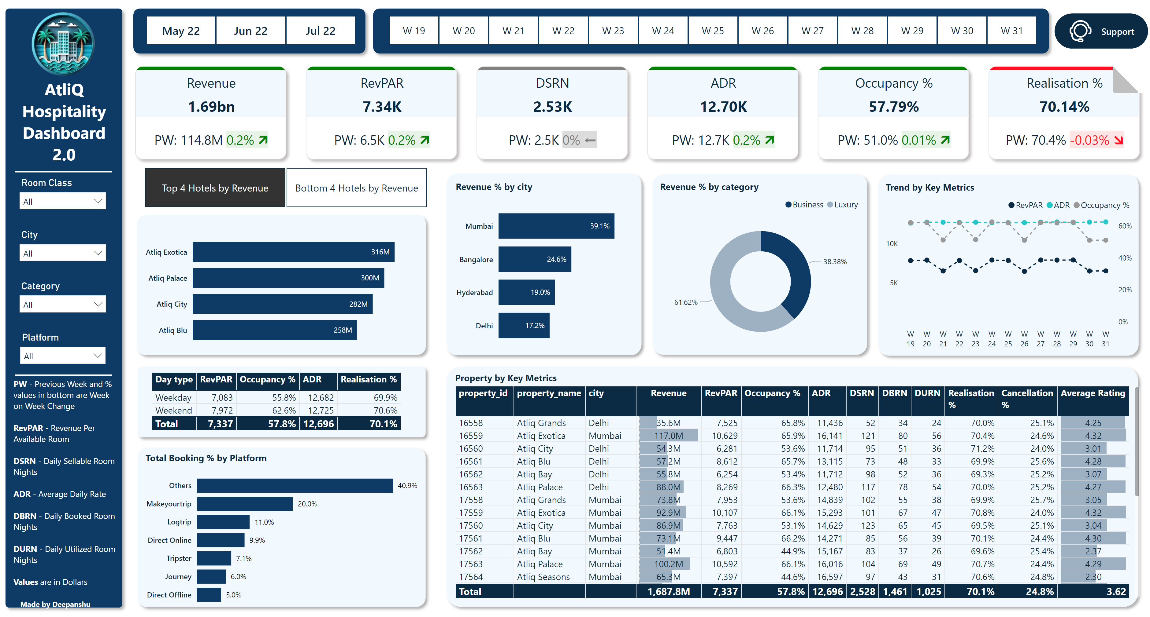
Home 2.0
Notes:
Revenue % by city
No alt text provided
shape
No alt text provided
Total Booking % by Platform
No alt text provided
shape
No alt text provided
clusteredBarChart
No alt text provided
shape
No alt text provided
cardVisual
No alt text provided
slicer
No alt text provided
slicer
No alt text provided
shape
No alt text provided
slicer
No alt text provided
shape
No alt text provided
shape
No alt text provided
image
No alt text provided
textbox
No alt text provided
slicer
No alt text provided
slicer
No alt text provided
textbox
No alt text provided
slicer
No alt text provided
slicer
No alt text provided
shape
No alt text provided
shape
No alt text provided
Revenue % by category
No alt text provided
Trend by Key Metrics
No alt text provided
shape
No alt text provided
shape
No alt text provided
tableEx
No alt text provided
shape
No alt text provided
Property by Key Metrics
No alt text provided
shape
No alt text provided
Support Button
No alt text provided
shape
No alt text provided
shape
No alt text provided
actionButton
No alt text provided
shape
No alt text provided
actionButton
No alt text provided
image
No alt text provided
shape
No alt text provided
actionButton
No alt text provided
actionButton
No alt text provided
actionButton
No alt text provided
actionButton
No alt text provided
actionButton
No alt text provided

